Slide 1



UNIT 6
AVL (Adelson-Velskii and Landis)-Tree
Dr. Dhanraj Verma , Professor
Computer Science & Engineering

Slide 2

UNIT-6
AVL Tree

Slide 3
Red-Black Trees (RBTs) are a type of self-balancing binary search tree (BST). They ensure that the tree remains approximately balanced, providing good performance for insertion, deletion, and search operations. Here's an overview of the key operations on Red-Black Trees:
Red Black Trees
AVL Tree

Slide 4

Properties of Red-Black Trees
Node Color: Each node is either red or black.
Root Property: The root is always black.
Leaf Property: Every leaf (NIL node) is black.
Red Property: If a red node has children, then the children are always black (no two red nodes can be adjacent).
Depth Property: Every path from a given node to its descendant NIL nodes has the same number of black nodes (black-height).

Slide 5

















Balanced Tree
Binary Search Tree gives advantage of Fast Search, but sometimes in few cases
we are not able to get this advantage. E.g. look into worst case BST
Balanced binary trees are classified into two categories
Worst search time cases
Height Balanced Tree (AVL Tree)
Weight Balanced Tree
for Binary Search Tree
50 20
40
30
30
40
20
50

Slide 6

Height Balanced Tree (AVL Tree)
A Balance factor of a node
right sub-tree respectively
Permissible balance factors:
| H_{L} - H_{R}|<=1, where H_{L,} H_{R} are heights of left and
A Left-High (balance factor +1)
The left-sub tree is one level taller than the right-sub tree
Balanced (balance factor 0)
The left and right sub-trees are both the same heights
Right-High (balance factor -1)
The right sub-tree is one level taller than the left-sub tree.
In height balanced tree, each node must be in one of these states
If there exists a node in a tree where this is not true, then such a tree is called
Unbalanced

Slide 7

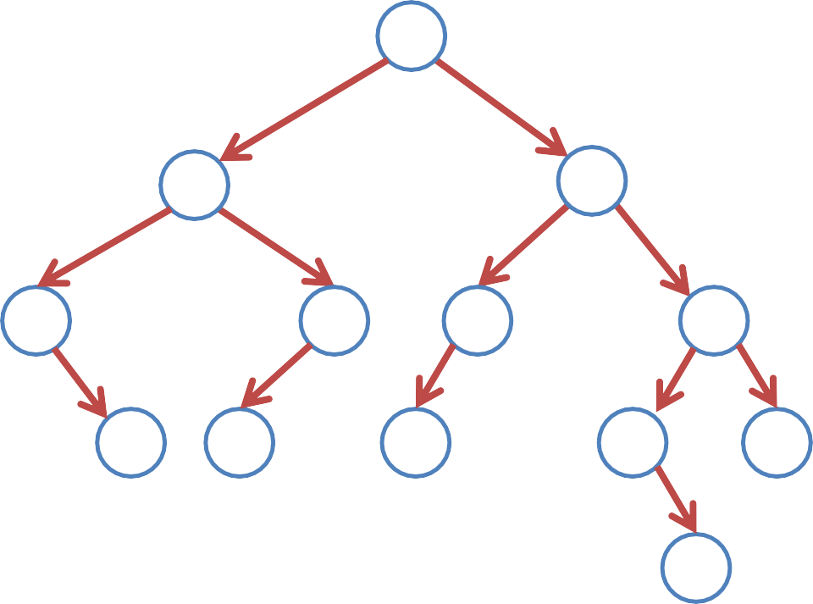
AVL Tree
0
-1
+1
-1
0
0
0
0
0
-1
+1
+1
0
0
-1
0
0
0

Slide 8





AVL Tree
Critical Node
Unbalanced Node
-1
Critical Node
Unbalanced Node
0
-1
0
+1
0
0
Sometimes tree becomes unbalanced by inserting or deleting any node
Then based on position of insertion, we need to rotate the unbalanced node
Rotation is the process to make tree balanced

Slide 9
AVL Tree Rotation
The following operations are performed on AVL tree...
Search
Insertion
Deletion

Slide 10

AVL Tree Rotation
There are four rotations and they are classified into two types.
AVL Tree Rotation
Single Rotation
Double Rotation
Left Rotation (LL Rotation)
Right Rotation (RR Rotation)
Left Right Rotation (LR Rotation)
Right Left Rotation (RL Rotation)

Slide 11
Operation on an AVL
In AVL tree, after performing operations like insertion and deletion we need to
check the balance factor of every node in the tree. Permissible balance factors:
If every node satisfies the balance factor condition then we conclude the
operation otherwise we must make it balanced.
If there exists a node in a tree where this is not true, then such a tree is called
Unbalanced
Rotation operations are used to make the tree balanced.
Rotation is the process of moving nodes either to left or to
right to make the tree balanced.

Slide 12




Single Left Rotation (LL Rotation )
In LL Rotation, every node moves one position to left from the current position.
To understand LL Rotation, let us consider the following insertion operation in
AVL Tree.
-2
Insert 8, 10, 12
-2
8
0
8
10
-1
-1
10
0
0
10
0
8
12
0
12
12
To make balanced we use LL Rotation which moves nodes one position to left
After LL Rotation Tree is balanced
Tree is imbalanced

Slide 13


Single Right Rotation (RR Rotation )
In RR Rotation, every node moves one position to right from the current
position.
To understand RR Rotation, let us consider the following insertion operation in
AVL Tree.
Insert 12, 10, 8
+2
+2
0
12
12
10
+1
+1
10
0
0
10
8
12
0
8
8
0
To make balanced we use RR Rotation which moves nodes one position to Right
After RR Rotation Tree is balanced
Tree is imbalanced

Slide 14
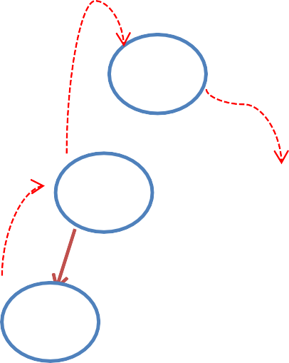

Left Right Rotation (LR Rotation )
The LR Rotation is a sequence of single left rotation followed by a single right
rotation
In LR Rotation, at first, every node moves one position to the left and one
position to right from the current position.
To understand LR Rotation, let us consider the following insertion operation in
AVL Tree. Insert 12, 8, 10
12
+2 +2
0
12
+2
12
10
-1
+1
0
0
-1
8
8
10
0
8 12
After LR Rotation
Tree is balanced
0
10
0
10
Tree is imbalanced
8
LL Rotation
RR Rotation

Slide 15





Right Left Rotation (LR Rotation )
The RL Rotation is a sequence of single right rotation followed by a single left
rotation
In RL Rotation, at first, every node moves one position to the right and one
position to left from the current position.
To understand RL Rotation, let us consider the following insertion operation in
AVL Tree. Insert 8, 12, 10
-2
8 -2
-2 12
0
12
10
+1
-1
0
0
+1
8
12
10
8 12
After RL Rotation
Tree is balanced
0
10
0
0
10
8
Tree is imbalanced
RR Rotation
LL Rotation

Slide 16
AVL Tree Rotation
The following operations are performed on AVL tree...
Search
Insertion
Deletion

Slide 17
Search Operation in AVL Tree
In an AVL tree, the search operation is performed with O(log n) time complexity.
The search operation in the AVL tree is similar to the search operation in a Binary
search tree.
We use the following steps to search an element in AVL tree.
Step 1 - Read the search element from the user.
Step 2 - Compare the search element with the value of root node in the tree.
Step 3 - If both are matched, then display "Given node is found!!!" and terminate the
function
Step 4 - If both are not matched, then check whether search element is smaller or
larger than that node value.

Slide 18
Search Operation in AVL Tree
Step 5 - If search element is smaller, then continue the search process in left subtree.
Step 6 - If search element is larger, then continue the search process in right subtree.
Step 7 - Repeat the same until we find the exact element or until the search element is
compared with the leaf node.
Step 8 - If we reach to the node having the value equal to the search value, then
display "Element is found" and terminate the function.
Step 9 - If we reach to the leaf node and if it is also not matched with the search
element, then display "Element is not found" and terminate the function.

Slide 19
Insertion Operation in AVL Tree
In an AVL tree, the insertion operation is performed with O(log n) time complexity.
In AVL Tree, a new node is always inserted as a leaf node.
The insertion operation is performed as follows.
Step 1 - Insert the new element into the tree using Binary Search Tree insertion logic.
Step 2 - After insertion, check the Balance Factor of every node.
Step 3 - If the Balance Factor of every node is 0 or 1 or -1 then go for next operation.
Step 4 - If the Balance Factor of any node is other than 0 or 1 or -1 then that tree is said to be imbalanced. In this case, perform suitable Rotation to make it balanced and go for next operation.

Slide 20

Construct an AVL tree by inserting numbers from 1 to 7
Insert 1
0
1
Tree is balanced
Insert 2
-1
1
0
Tree is balanced
2

Slide 21

Construct an AVL tree by inserting numbers from 1 to 7
Insert 3
-2
1
1
0
-1
2
2
After LL
Rotation
2
0
0
0
3
Tree is Imbalanced
3
1 3
Tree is Balanced
LL Rotation

Slide 22

Construct an AVL tree by inserting numbers from 1 to 7
Insert 4
-1
2
0
-1
Tree is balanced
1
3
0
4

Slide 23



Construct an AVL tree by inserting numbers from 1 to 7
Insert 5
-1 -2
-2
2
2
0
-1 -2 0
-2
0
0
1
3
After LL Rotation at 3
2
1
3
0
0
0 -1
-1
1
4
Node is Imbalanced
4
4
0
0
0
0
3 5
Tree is balanced
5
5
LL Rotation at 3

Slide 24


Construct an AVL tree by inserting numbers from 1 to 7
Insert 6 Node is Imbalanced
0 -2
0
0
0
-2
22
4
2
0 -1
After LL Rotation at 2
0
0
0
-1
1
4
2
5
0
0 -1
1
4
0
0
0
0
-1
0
3
5
3
6
3
5
1
0
0
6
Tree is balanced
6
LL Rotation at 2

Slide 25



Construct an AVL tree by inserting numbers from 1 to 7
Insert 7
0 -1
0
Node is Imbalanced
4
After LL Rotation at 5
4
0
0 0
0
0
0 -2
4
2
5
2
5
0
0
0
0
0 -1 ⁰
0
0
0 0
2
6
3
6
1
3
6
0
0
1
0
1
3 5
Tree is Balanced
0
7
LL Rotation at 5
7
7

Slide 26
Deletion Operation in AVL Tree
The deletion operation in AVL Tree is similar to deletion operation in BST.
But after every deletion operation, we need to check with the Balance Factor
condition.
If the tree is balanced after deletion go for next operation otherwise perform suitable rotation to make the tree Balanced.

Slide 27


www.paruluniversity.ac.in

